Slide 1
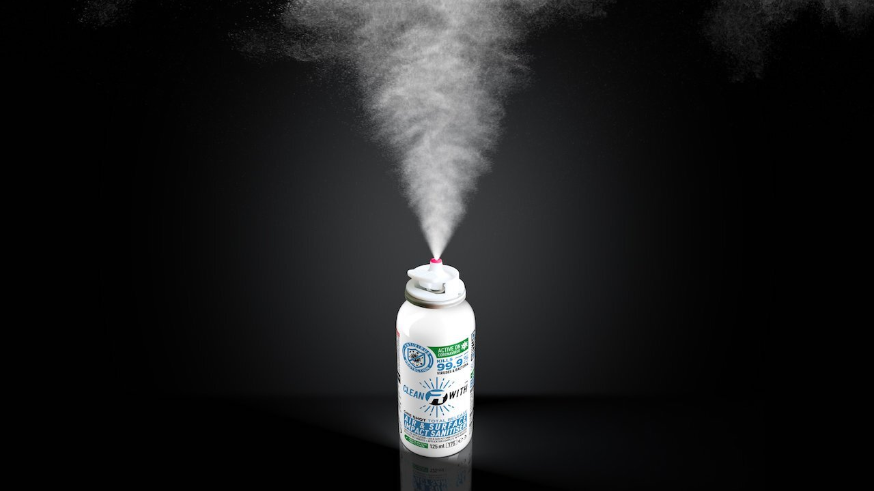
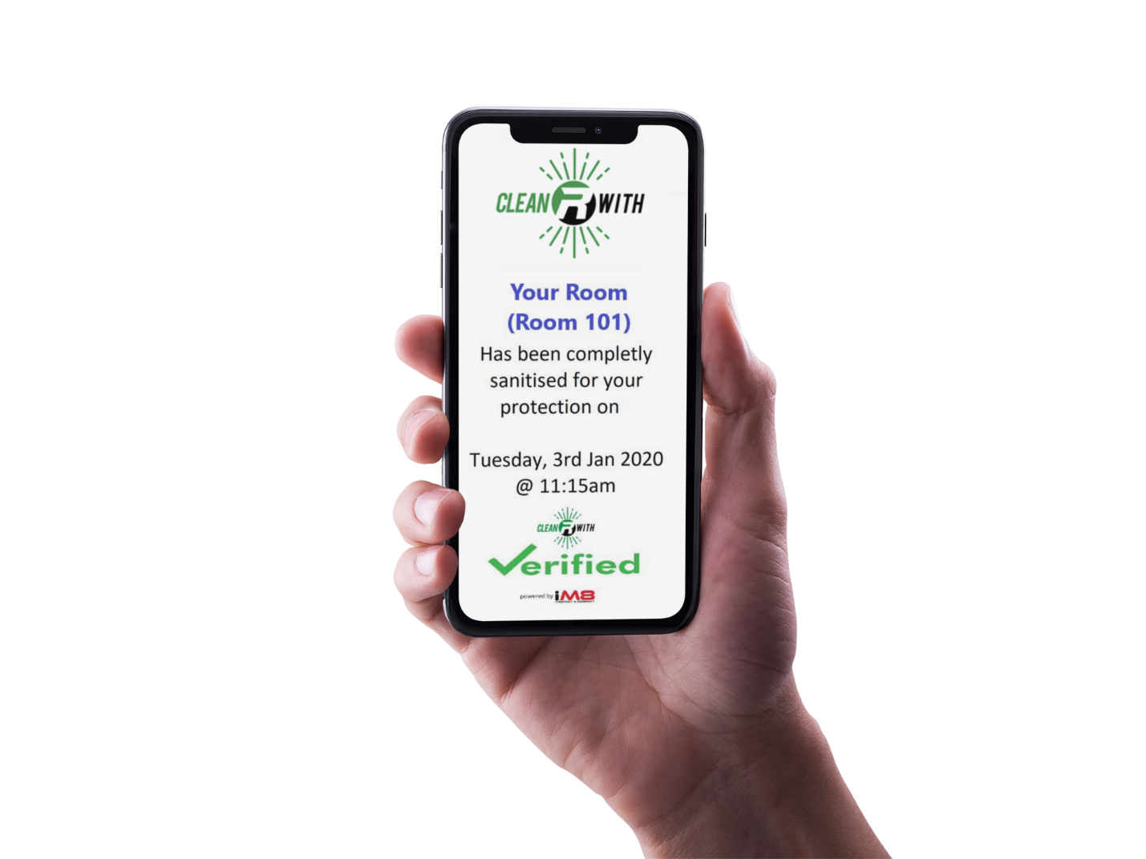
MAXIMUM SECURITY,
MINIMUM EFFORT.

Slide 2
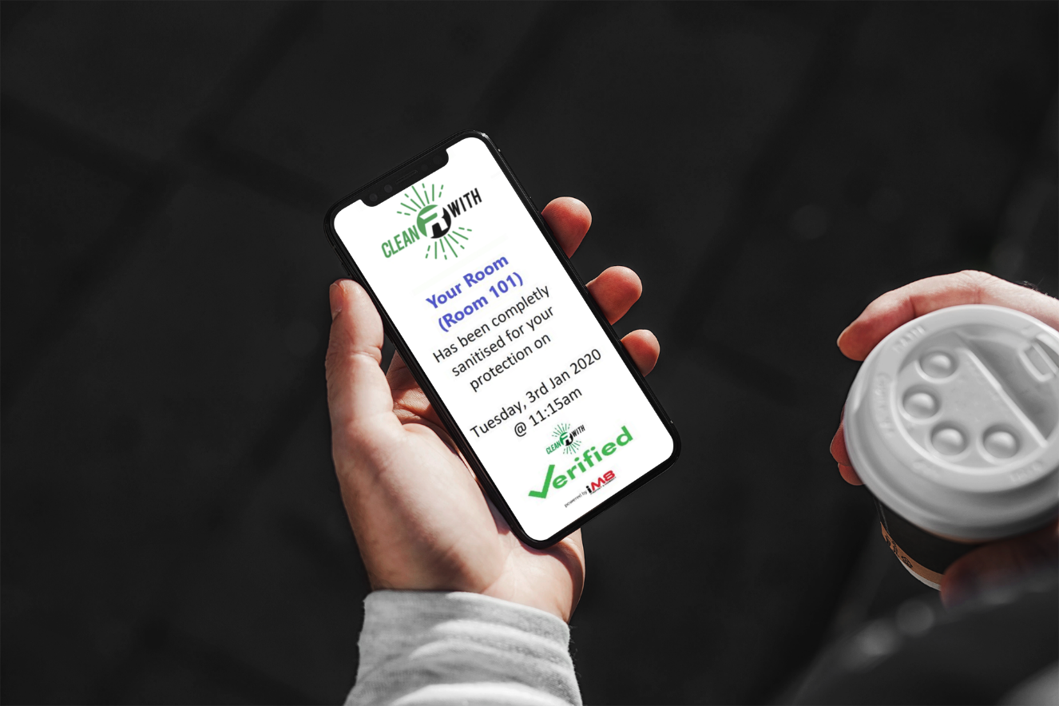
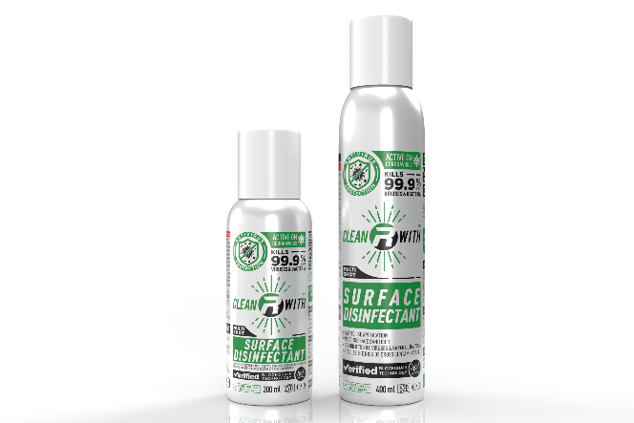
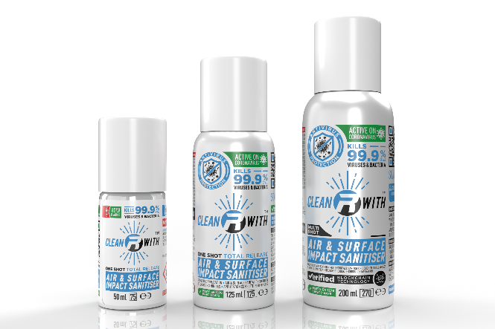
TRACEABLE
BLOCKCHAIN VERIFIED
SANITISATION
SURFACE
200 mL Multi Shot
400 mL Multi Shot
AIR & SURFACE
50 mL One Shot
125 mL One Shot
200 mL Multi Shot

Slide 3
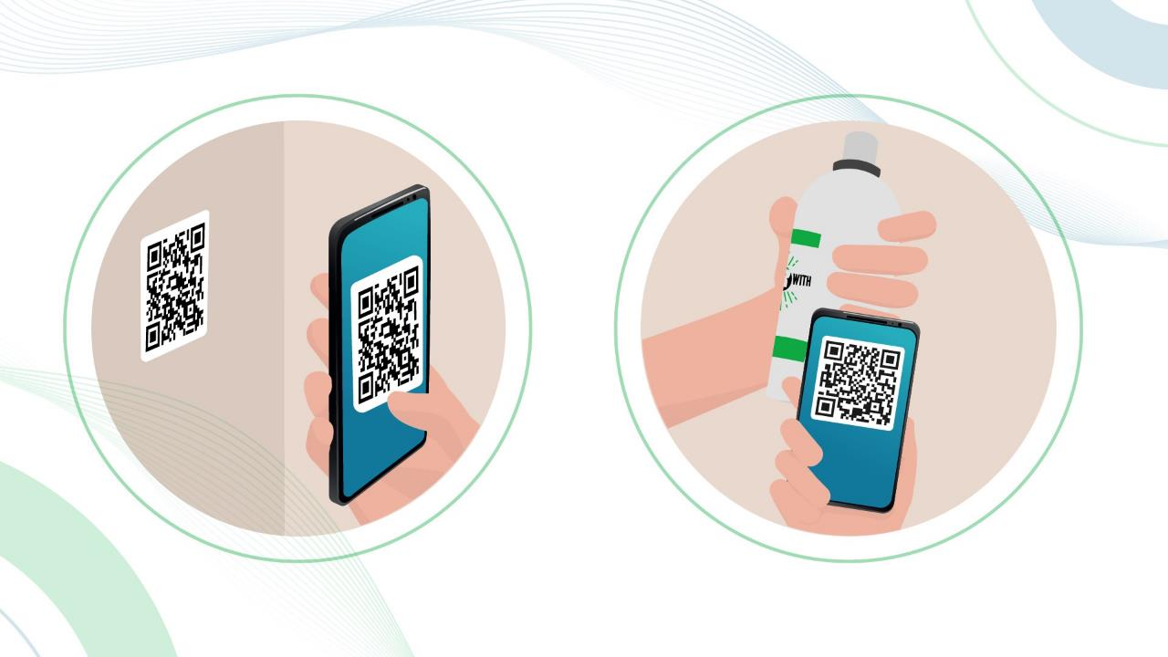
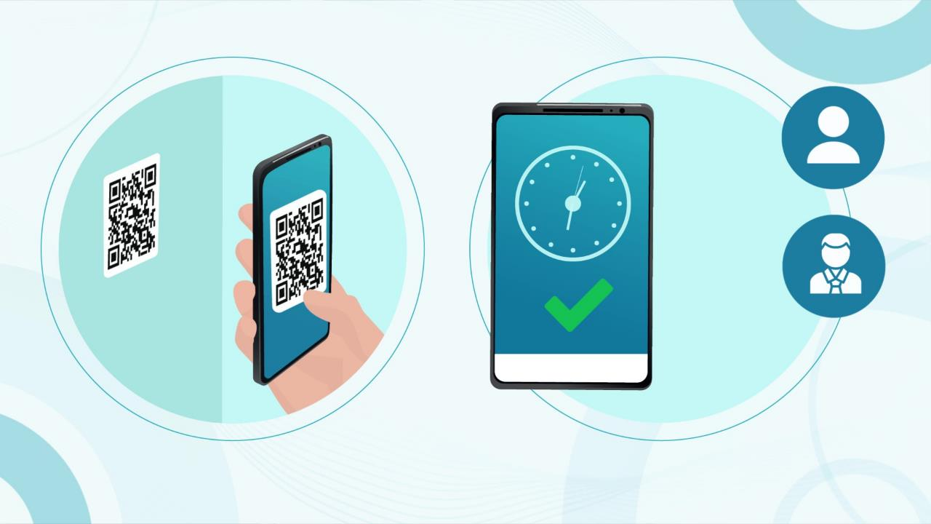

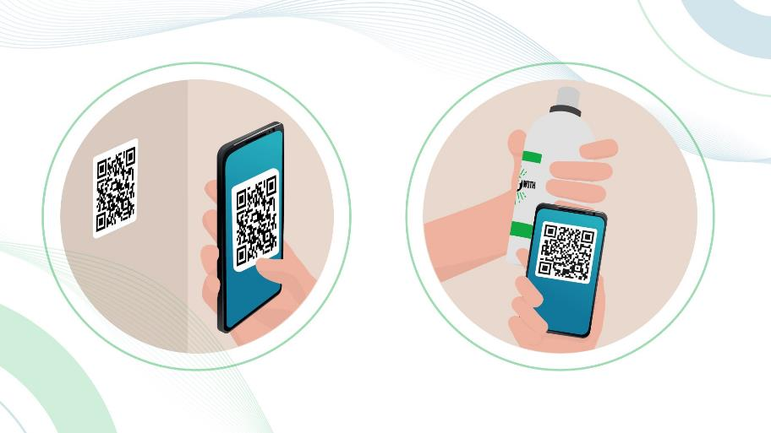
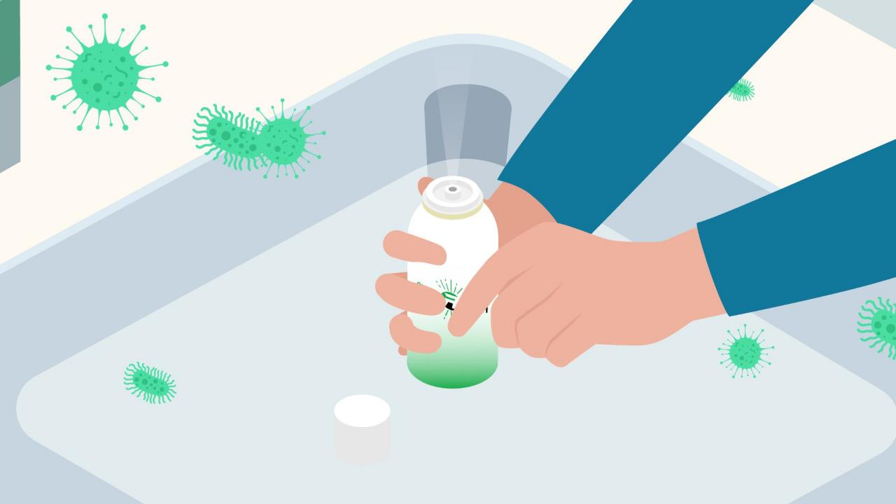
SIMPLY
ACTIVATE
Depress the diffuser to release the contents. Leave to act before re-entering the area.
SIMPLY
SIMPLY
REGISTER
VERIFY
Scan the QR-Code in the area with the CleanRwith App. Then scan the QR-Code on the sanitiser can.
Customers and staff can now verify by scanning the QR-Code in the area. A blockchain sanitisation certificate is displayed.

Slide 4
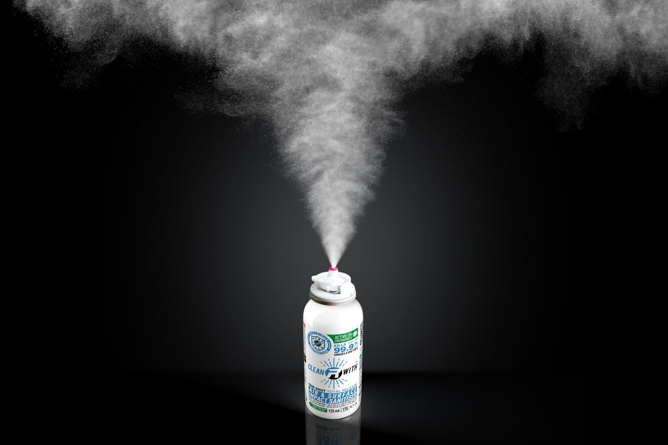
AIR & SURFACE
PEACE OF MIND FOR YOU AND YOUR CUSTOMERS
99.9% Disinfection
Virucidal EN14476, Bactericidal EN13697+EN1276, Fungicidal EN13697
Our range of aerosol disinfectant products are tested to meet the highest regulatory standards. With the one shot, the air and all surfaces in the room are disinfected completely without residue. The product evaporates completely, there is no need to wipe.
ONE SHOT
MAXIMIUM EFFICIENCY

Slide 5
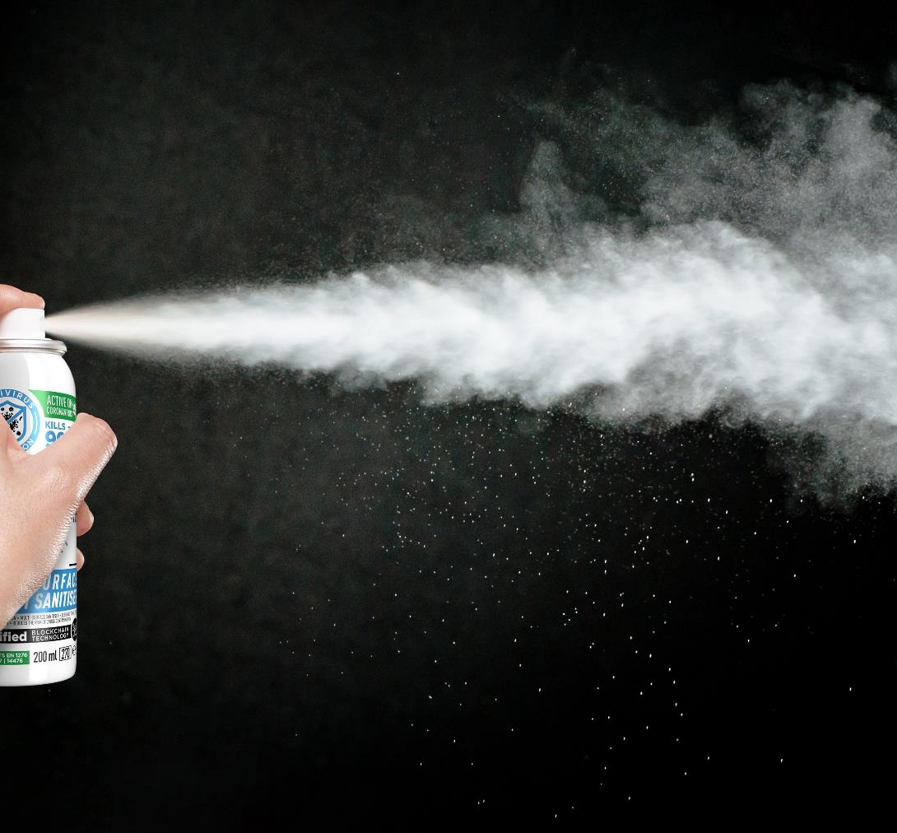
SURFACE DISINFECTION
FAST AND EFFORTLESS APPLICATION
99.9% Disinfection
Virucidal EN14476, Bactericidal EN13697+EN1276, Fungicidal EN13697
With our Multi-Surface Spray you conveniently treat any area. Simply spray and go. The area is immediately ready to be used again and full protection of the treated surfaces is reached after 15 minutes of exposure time. The product evaporates completely, there is no need to wipe.
Notes:
To change the image behind the Mock up.
Select the layer - > Right Click -> Send to Back -> Delete the image -> Drag & Drop your Own Picture -> Send to Back (again)

Slide 6







TRACEABLE
TRANSPARENT
Thanks to unique QR-Codes, the dedicated CleanRwith app and your CleanRwith dashboard, you can trace every sanitization in real time.
Customers and staff can scan the QR code in an area to receive instant verification as to when the area was last sanitised.
EFFICIENT
SECURE
A fully digital sanitisation protocol. Register with one scan and monitor from anywhere. No paper, No hassle.
99.9% aerosol disinfection paired with a blockchain verified protocol. Less margin for error, less risk.
Notes:
To change the image behind the Mock up.
Select the layer - > Right Click -> Send to Back -> Delete the image -> Drag & Drop your Own Picture -> Send to Back (again)

Slide 7




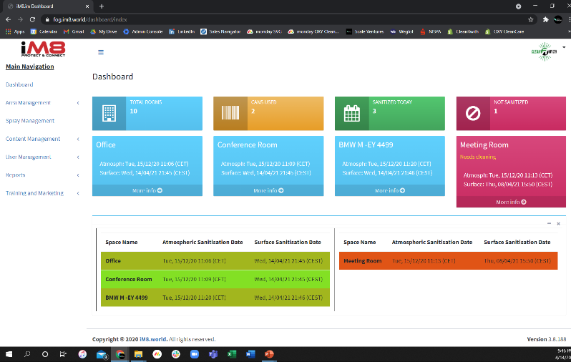


USER-FRIENDLY
ONE DASHBOARD, FULL CONTROL
CleanRwith is the new standard for safe hygiene concepts. It provides full sanitisation traceability and accountability to customers, staff and regulators.
LIVE MONITORING
EASY ACCESS RECORDS
Ensure sanitisation protocols are followed correctly and make spaces available faster.
Manage compliance and mitigate exposure to unwarranted claims.
CUSTOMISED SET-UP
BLOCKCHAIN VERIFICATION
Define your individual sanitisation protocol, assign areas and set alerts.
Each QR-Code is unique and all records are secured on a banking level blockchain ledger.

Slide 8


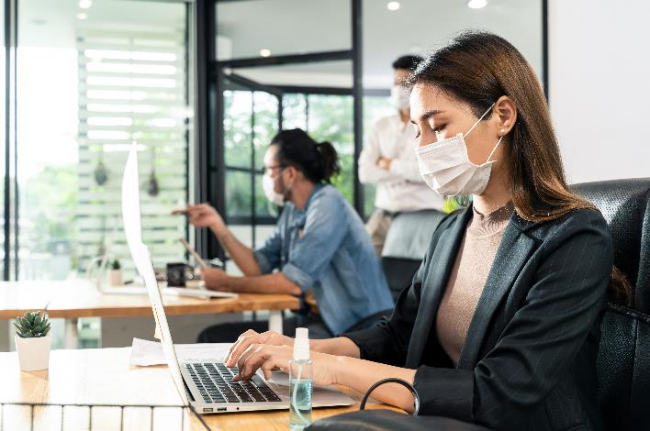


RANGE OF APPLICATION
MAKING PUBLIC LIFE SAFE AGAIN
A state-of-the-art system solution, CleanRwith delivers you an effective and efficient strategy to build trust with your customers and manage regulatory challenges.
WHEREVER YOU ARE
Hospitality, Public Transport, Office Space, Health Care, Public Buildings and many more.

Slide 9









REFERENCES
TRUSTED BY GREAT COMPANIES
CleanRwith products are already trusted by leaders in many industries to increase the safety of their customers and staff. Allowing them to make their life easier and future proof their businesses by giving them a real competitive edge.

Slide 10

LOCATION
CONTACT US
HOHE BLEICHEN 8
20354 HAMBURG (GERMANY)
SALES@SCALEVENTURESGROUP.COM
+49 (0) 40 555536-278
GET IN TOUCH
SCALE VENTURES GMBH
OFFICE HOURS
WEB
MO-FRI 9:00 – 18:30
www.scaleventuresgroup.com
© Copyright 2021 Scale Ventures GmbH

